Slide 1
Summary master Easter 2020
Ivar Svalheim Haugerud

Slide 2
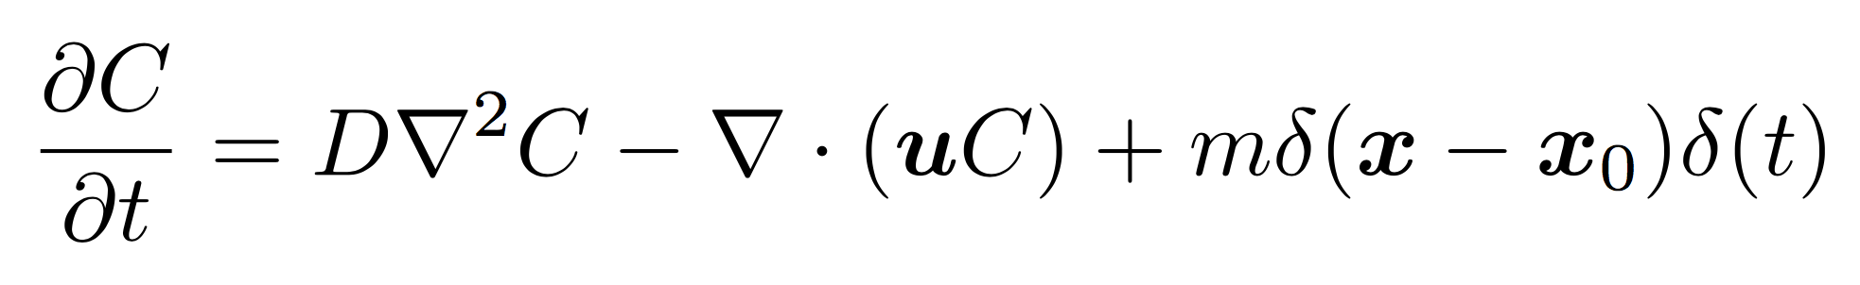
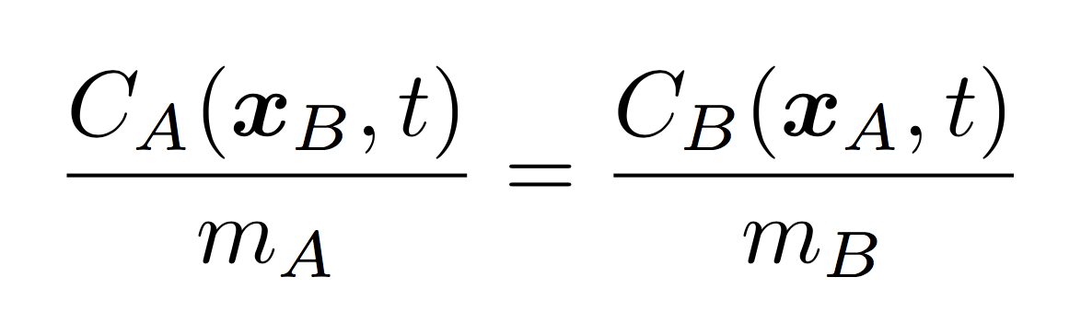

Reciprocal relation

Slide 3
Reciprocal relation

Slide 4
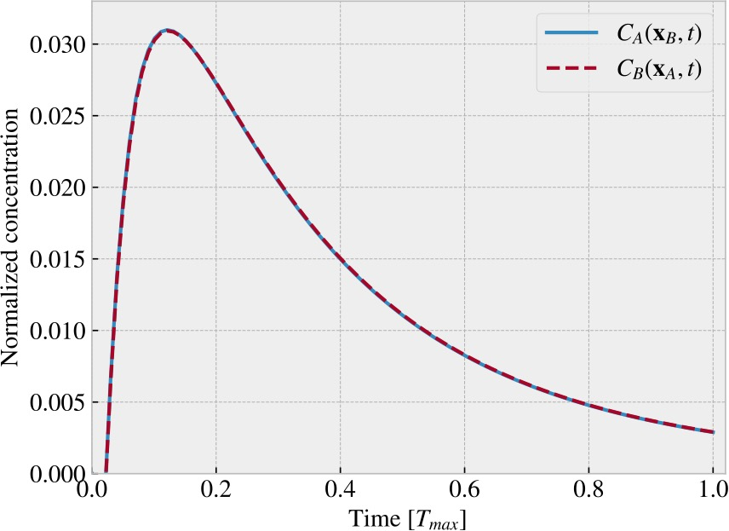
Reciprocal relation

